Slide 1
Project Roadmap: Human Activity Recognition
Name | Enrollment Number | Email ID | Section | Phone Number
Ajinkya Bedekar | U101116FCS183 | Ajinkya.Bedekar@st.niituniversity.in | C5 | 7389664860
Ankit Gupta | U101116FCS267 | Ankit.Gupta@st.niituniversity.in | C5 | 9660765363
Deeptonabho Dutta | U101116FCS030 | Deeptonabho.Dutta@st.niituniversity.in | C5 | 9674525644
Dhruva Agarwal | U101116FCS177 | Dhruva.Agarwal@st.niituniversity.in | C5 | 7339764074

Slide 2
Problem Identification

Slide 3
Overview
Problem Statement
To find out about the suspicious activities at the railway station, Indian Government decided to make the software which can read the real time video and classify the activities going on in video as suspicious our non-suspicious.
Expected delivery
April 30, 2019
Biggest risk
To avoid ambiguity about whether the activity performed by human at railway station is really suspicious or not

Slide 4
Industrial Development Environment and Tools

Slide 5
Tools to be Used
Build Tool : PyBuilder
Central Repository : GitHub
Integration Tool : Jenkins
Testing Tool : pytest
IDE : PyCharm

Slide 6
Technologies To Be Used
THOSE TAUGHT IN CLASS
OpenCV
THOSE WHICH ARE SELF-TAUGHT BY US
Neural network
Convolutional Neural Network
Keras
TensorFlow
YOLOv3 (object recognition framework developed by Darknet)

Slide 7
Schedule

Slide 8
Object Detection: Learning + Implementation
Human Activity Recognition: Learning + Implementation
Final Implementation
1 February 2019
20 February 2019
10 March 2019
1 April 2019
20 April 2019
Object Tracking: Learning + Implementation
Train Software on Suspicious Activities Dataset

Slide 9
Project Plan

Slide 10
Roles and Responsibilities
Name | Module
Ajinkya Bedekar | Object Detection
Ankit Gupta | Object Tracking
Deeptonabho Dutta | Human Activity Recognition (Suspicious)
Dhruva Agarwal | Train Software and Final Implementation

Slide 11
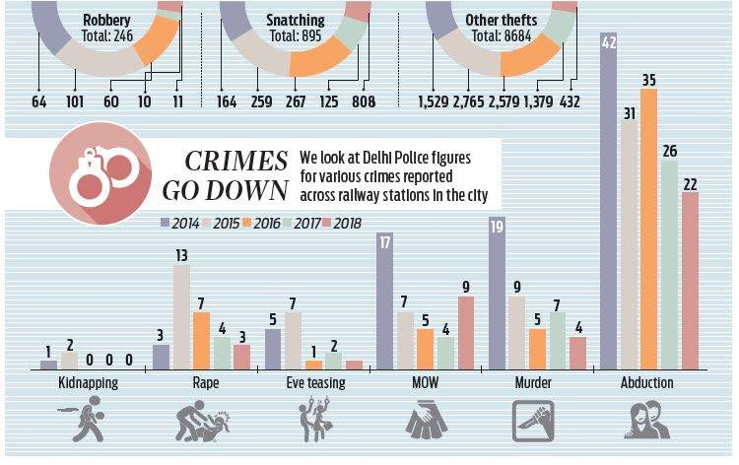
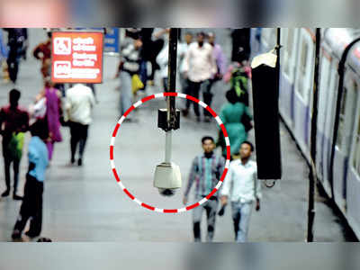

Slide 12
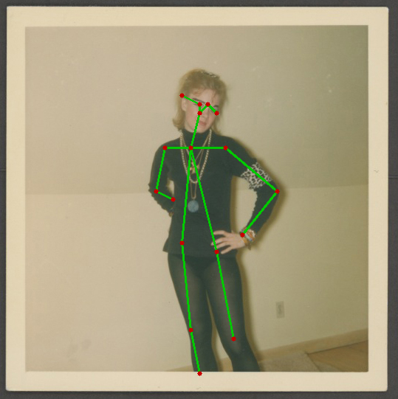
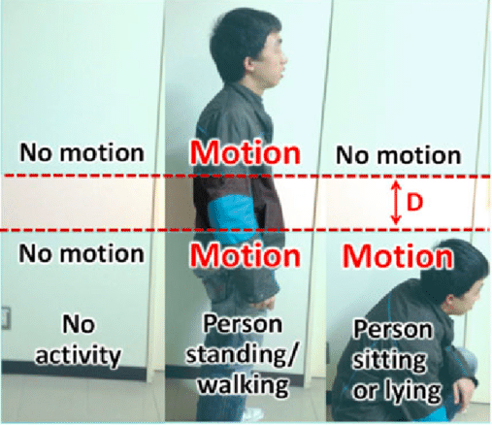
Step1: Human body recognition Step 2: Basic human activity tracking

Slide 13
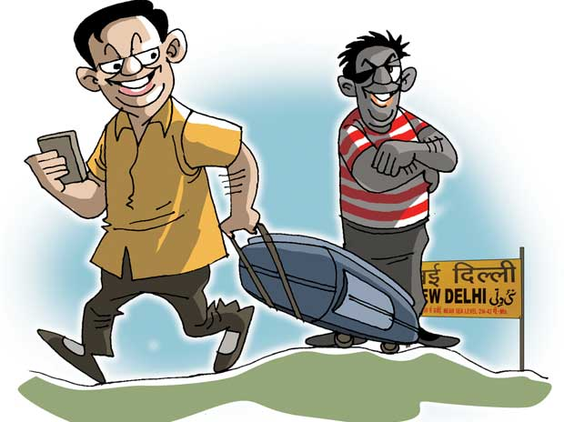
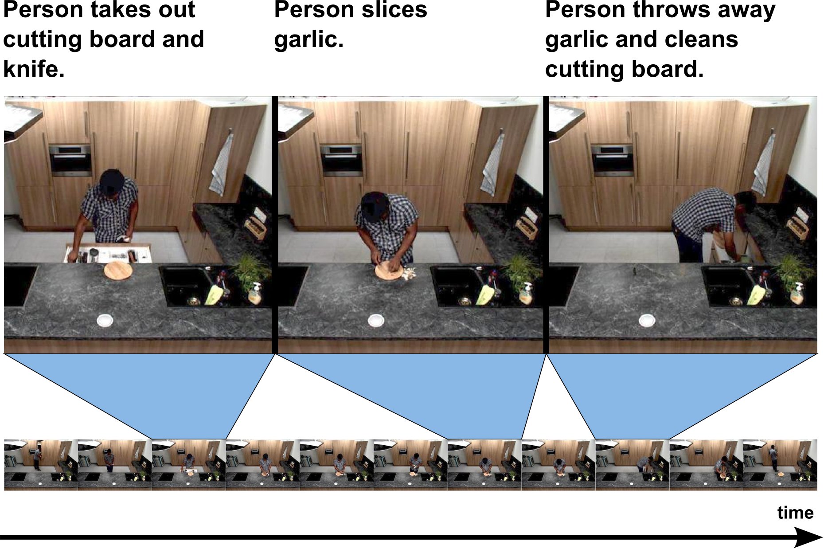
Step3: Defining unambiguous suspicious Step 4 : Training the model
activities in a railway station

Slide 14
Scope
Unambiguous
(Suspicious) Activities
Tampering with security equipment
Documenting transit equipment, facilities or security equipment
Acts of violence
Pick pocketing
Snatching of objects
Violating rules

Slide 15
Workflow
Extract frame from video
Image Preprocessing
Detect Activity
Use trained model to detect suspiciousness
Yes
No
Send alert to admin
Proceed to next frame

Slide 16
Extract image sequence from video
Image Preprocessing
Workflow
(for Deep Learning Algorithm)
Feature Extraction
Divide Dataset
Training Set
Testing Set
Build Recognition Model
Apply Model on Test Data
Repeat using other models to get best score
Evaluate Accuracy using scoring

Slide 17
Next Deliverables
Start developing the algorithm for detecting objects real-time through camera

